Slide 1

to my presentation

Slide 2

•Tamanna Akter
•ID: 221-15-5298
•Section :61_M
•Department of CSE

Slide 3
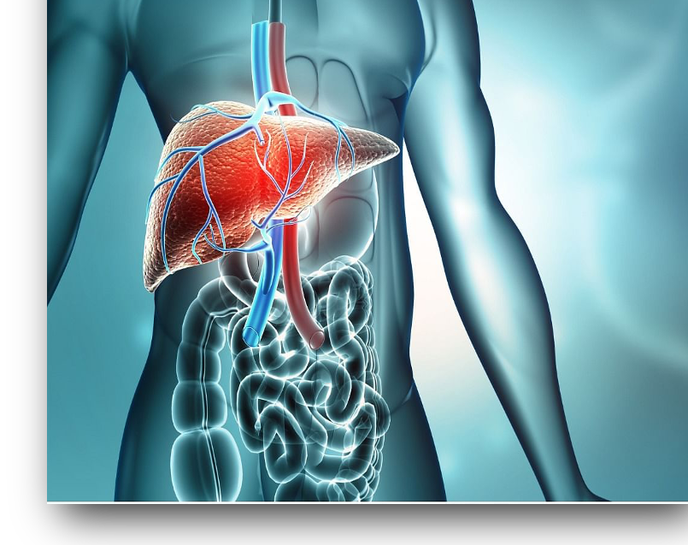
Dataset(From Kaggle): Liver Disease Patient Dataset 30K train data.

Slide 4
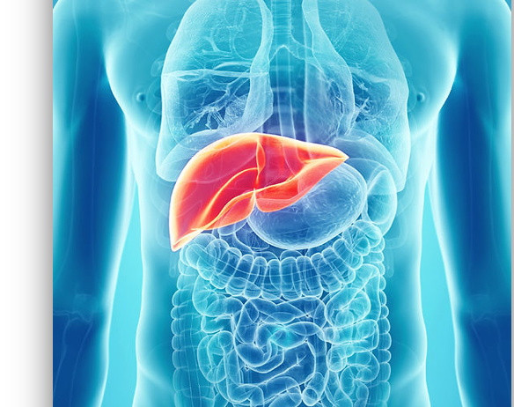
Title:
Liver Infection Prediction Analysis ,using Machine Learning to Evaluate Analytical Performance in Neural Networks by Optimization Techniques.

Slide 5

Problem statement:
Liver infection is a common disease, which poses a great threat to human health, but there is still able to identify an optimal technique that can be used on large-level screening.

Slide 6
Solutions:
This paper deals with ML algorithms using different data sets and predictive analyses.
Therefore, machine ML can be utilized in different diseases for integrating a piece of pattern for visualization.
This paper deals with various machine learning algorithms on different liver illness datasets to evaluate the analytical performance using different types of parameters and optimization techniques.
The selected classification algorithms analyze the difference in results and find out the most excellent categorization models for liver disease.
Machine learning optimization is the procedure of modifying hyperparameters in arrange to employ one of the optimization approaches to minimize the cost function. It is crucial to minimize the cost function.

Slide 7
Literature survey:
Name | Technique | Accuracy
Heba Ayeldeen | the liver phase by decision tree | 95%
Somaya Hashem | e SVM algorithm | 70.42%
 | SVM & DT | 74.2%
Sanjay Kumar, along with Sarthak Katyal | created a categorization model using several data removal algorithms.
P.M.Goel | A document based on two categorization techniques, NB and FT | 76.6% accuracy in FT
Y Yugal Kuma & G. Sahoo | document based on the unusual categorization technique | the accuracy is more than [1] (2017 Sontakke, Sumedh, et al.) 82.45% com-pare to further algorithms, and it gives an accuracy of 97.27%

Slide 8
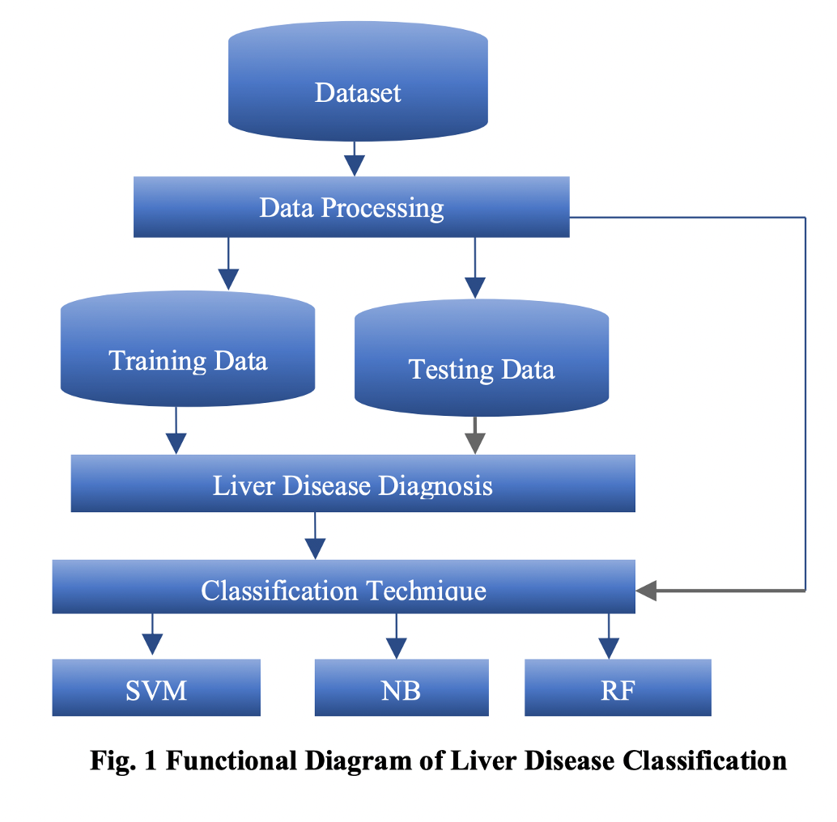

Slide 9
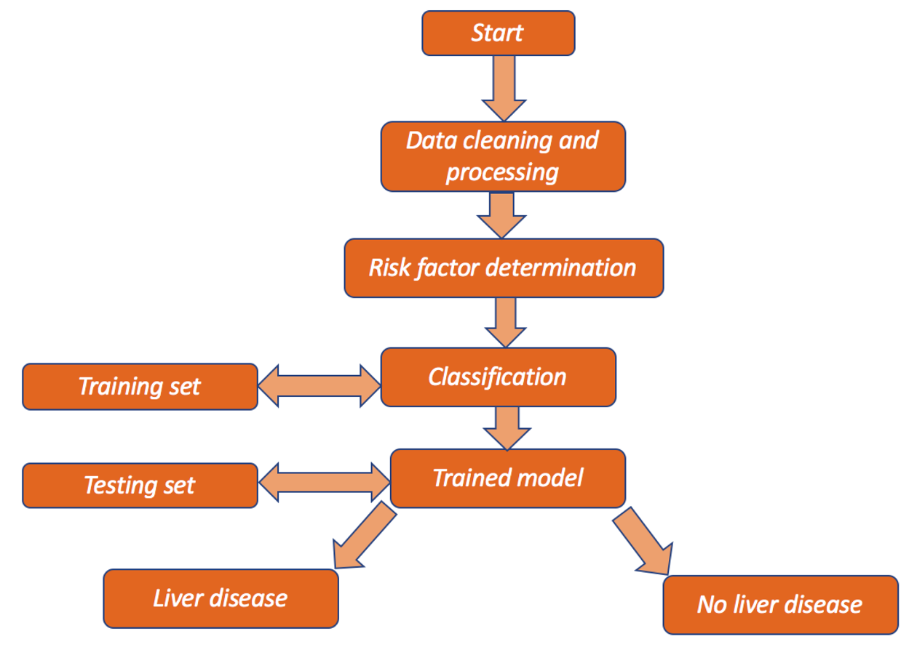
Fig-2: Workflow diagram

Slide 10


